Slide 1

Campus Enrollment Forum
Katie Lynch, Sr. AVP of Enrollment Management
Craig Relyea, AVP for Strategic Marketing and Communications
Lori Beth Way, Vice Provost of Academic Planning and Dean of Undergraduate Education
March 18, 2026

Slide 2

Background

Slide 3
Why a new SEM Plan?
Governor’s Budget called for CSU enrollment growth which caused the Chancellor’s Office to look at enrollment trends on individual campuses differently
External review identified opportunities for potential enrollment stabilization with additional investment in recruitment and retention efforts and organizational restructuring
Alarming enrollment projections if we maintain the status quo and did not invest in new strategies

Slide 4
Enrollment Impact on Budget
CSU Budget Allocation
Funding received from the CSU based on CA resident FTEs
Re-allocation of funds to over-enrolled campuses if we are beyond 10% from our CSU enrollment target
We are currently 22.3% from that target.
Tuition and Fee Revenue
Average net tuition revenue per FTE is $7,500/year
The enrollment decline from 2024-2025 to 2025-2026 resulted in over $8 million in revenue lost.

Slide 5
Strategic Enrollment Management
Plan Development

Slide 6
Strategic Enrollment Management (SEM)
President Mahoney announced in August that we are going to double down our efforts on enrollment; including an organizational restructuring and a request for funding from the Chancellor’s Office
The development of a new SEM Plan kicked off immediately and was completed on December 24, 2025
  Many thanks to the 83 staff, faculty and administrators who contributed!
Aggressive timeline to try to turn the tide on our rapid decline and to put the plan in to action as soon as possible
Research-based, best practices informed all sections of the plan
Plan aligns with the system-wide student success framework and system-wide strategic enrollment management plan
Resources from the Chancellor’s Office to support approved enrollment initiatives

Slide 7
Strategic Enrollment Management
Plan

Slide 8
Recruitment Plan: Project Blueprints
Recruitment and Territory | Freshman | Transfer | Western Undergraduate Exchange | Specialized Populations | Search | Tours and Visits
Partnership Engagement | Dual Enrollment | Ambassador Toolbox | Alumni Engagement | Orientation | Academic Offerings
 |  | Affordability | Financial Aid Leveraging | Scholarships
Marketing Strategy | Website Content, Maintenance and Governance | Social Media Strategy | Journey Mapping | Messaging Highlights | Differentiation | Parent, Guardian & Support Engagement

Slide 9
SEM Plan: Recruitment Strategy Changes
Past Efforts
Recruitment Territories: Broad geographical regions, SoCal focus, “yes” mentality to requests without ROI considered
Partnerships: Relationship based, EOP and Metro focused
Tours and Visits: General campus tours, specific campus visits, weekdays and every other Saturday
Campus Partners: Uncoordinated work which lead to duplication of efforts, confusion and lost opportunity, event participation, calling campaigns
Specialized Populations: Single day events/programs, general communication w/ some ad hoc outreach
Affordability and Financial Aid: Decentralized scholarship administration, vague messaging
New SEM Plan
Recruitment Territories: Increase local intensity, maintain SoCal presence, careful consideration of request to maximize efforts
Partnerships: Institution-wide partnerships, focused on local CBOs, earlier exposure, Guaranteed and Direct Admissions programs
Tours and Visits: Population specific opportunities, increased campus visits w/ integrated classroom exposure, expand to evenings and increase Saturdays during peak times
Campus Partners: Ambassador Toolbox with clear directions on how to partner with us, messaging highlights, tour & visit opportunities, best practices, resources to maximize efforts
Specialized Populations: Segmented communications, investment in population specific outreach and collateral
Journey Mapping: Differentiate messaging based on audience (FTF, Transfer, supporter, etc.)
Affordability and Financial Aid: Propose centralized scholarship administration with automated eligibility, improved software, clearer messaging re: cost, value and ROI

Slide 10
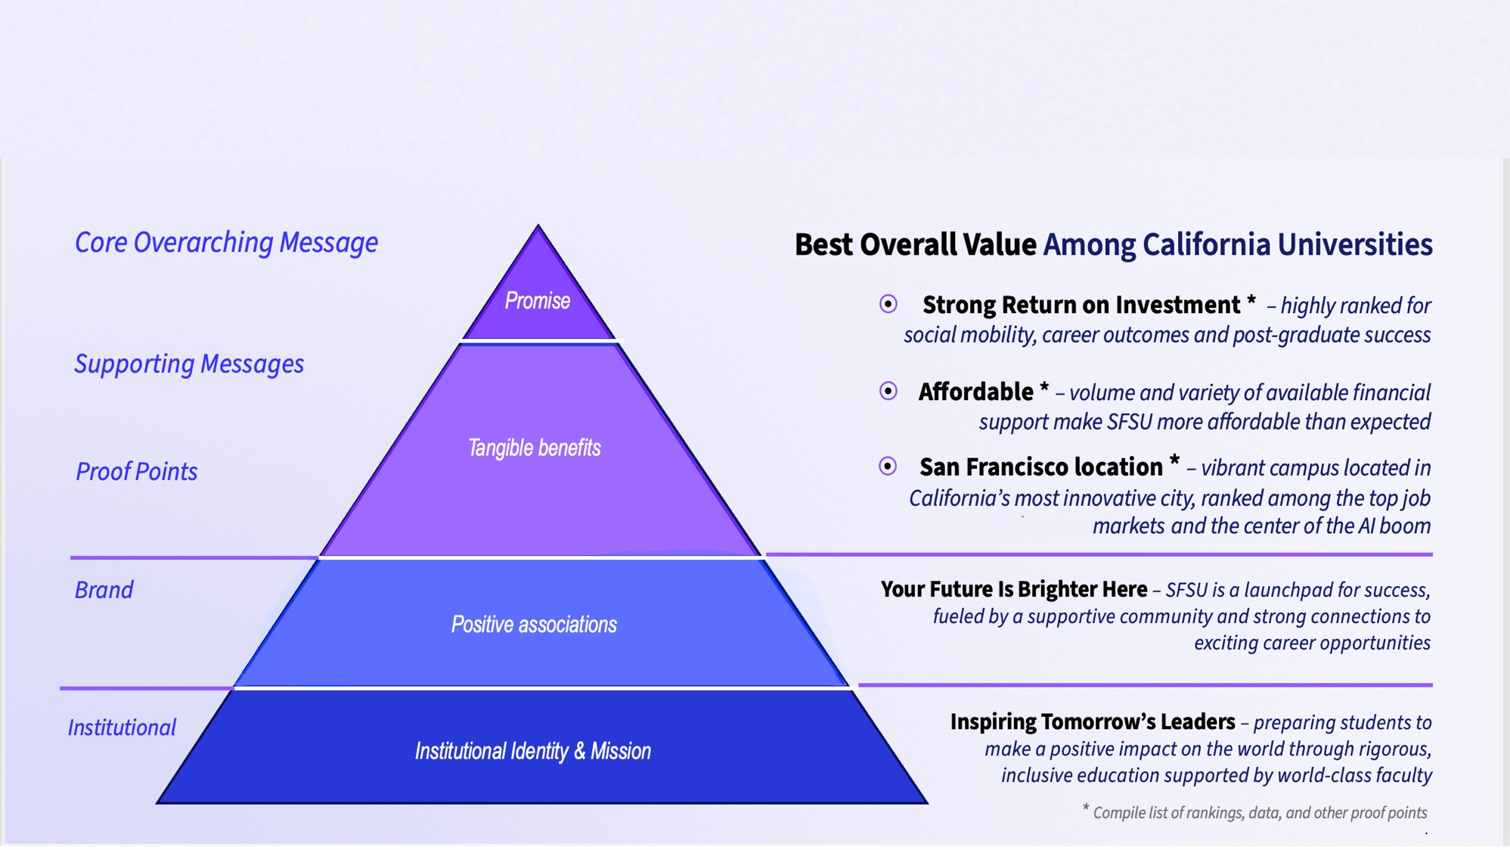
SEM Plan: Messaging Shift

Slide 11



SEM Plan: Marketing Shift
Messaging focused on student-centered value propositions and benefits
Data-based
decision making
SMC
re-alignment
Consistent reinforcement across multiple channels
Student
input / student
voices
Content &
Storytelling
Centralized website
Utilize peer-to-peer storytelling to engage and establish trust
AI discoverability is now a core marketing channel
Emphasize
Social Media
Optimize for
AI Discovery
Emphasis on Marketing vs Communication

Slide 12
Recruitment Plan: Progress
Territory realignment/reassignments with more measurable targets
Guaranteed and Direct Admission with CCSF and SFUSD
Direct admissions for WUE students through Niche
MOUs signed with new Enrollment Partners
Release of the Ambassador Toolbox
Established Orientation Advisory Group
Refined messaging priorities
Launch of TikTok

Slide 13
Retention Plan: Project Blueprints
Administrative Barriers | Credit Accumulation | Leveraging Data/Analytics for Proactive Outreach | Student Service Consistency and Expectations
Retention Grant Strategy | Belonging and Identity | Parent, Guardian Support Engagement | Alumni Engagement
Communication Policy and Expectations | Visible Career Connections | Adaptive and Responsive Pedagogy | Artificial Intelligence
 | Re-enrollment Strategy

Slide 14
SEM Plan: Retention Strategy Changes
Past Efforts
Reducing Administrative Barriers: Effective elimination, focused on finances, processes and technology
Credit Accumulation: Think 30 campaign, documented success of students enrolled in 30 units/year
Retention Grants: Uncoordinated and relationship based
Belonging and Identity: Siloed activities, lack of coordination
Communication: Coordination among key student support offices, variety of communication platforms, misuse of communication channels
Visible Career Connections: Direct connection to career and skill building not always clear
New SEM Plan
Reducing Administrative Barriers: Continued elimination, creation of joint student financial team, improved technology and CO open to policy changes
Credit Accumulation: Enrollment in 15 units at time of orientation, intervention and communication for use of summer
Retention Grants: Streamlined, data-driven approach
Belonging and Identity: Coordinated calendars between DECI, Student Life and Athletics, strategies for creating sense of belonging within the college/program
Communication: Guidelines and best practices for conveying messages and opportunities, increased use of social media
Visible Career Connection: Clear connection to skills and career for all majors in print and on web, expand internship opportunities, promote relevant alumni stories

Slide 15
Retention Plan: Progress
Revised goals for Financial Services workgroup to address administrative financial barriers
Funding for AI Student Commons
Funding for additional AI Teaching Squares in CEETL
Investment in Faculty Career Champions to further integrate careers into curriculum
Search underway for AVP of Workforce Partnerships
Partnership with Motimatic and InsideTrack on re-enrollment efforts
April Registration Party to promote early registration

Slide 16
Next Steps

Slide 17
Next Steps
SEM Plan Lead identification
  Confirm leads for each outlined strategy with vice presidents
  Follow up meeting for strategy leads to review tracking documents and timelines
Weekly updates to Cabinet and Quarterly reports on progress

Slide 18
Questions

Slide 19
Ambassador Toolbox

Slide 20
Opportunities to Help

Slide 21

Annual Yield Call Campaign: Call for Ambassadors
Make calls to admitted students and encourage them to attend Explore SFSU and enroll at SFSU!
Calls are distributed by academic department or special interests, when possible. General calls are distributed among other colleagues.
Sign up by completing this Qualtrics form: Sign Up

Slide 22

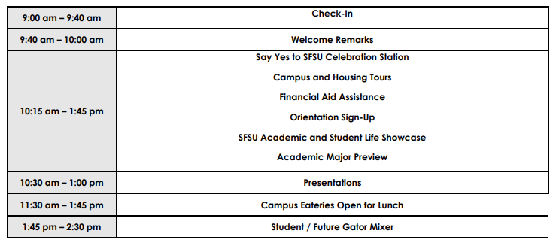

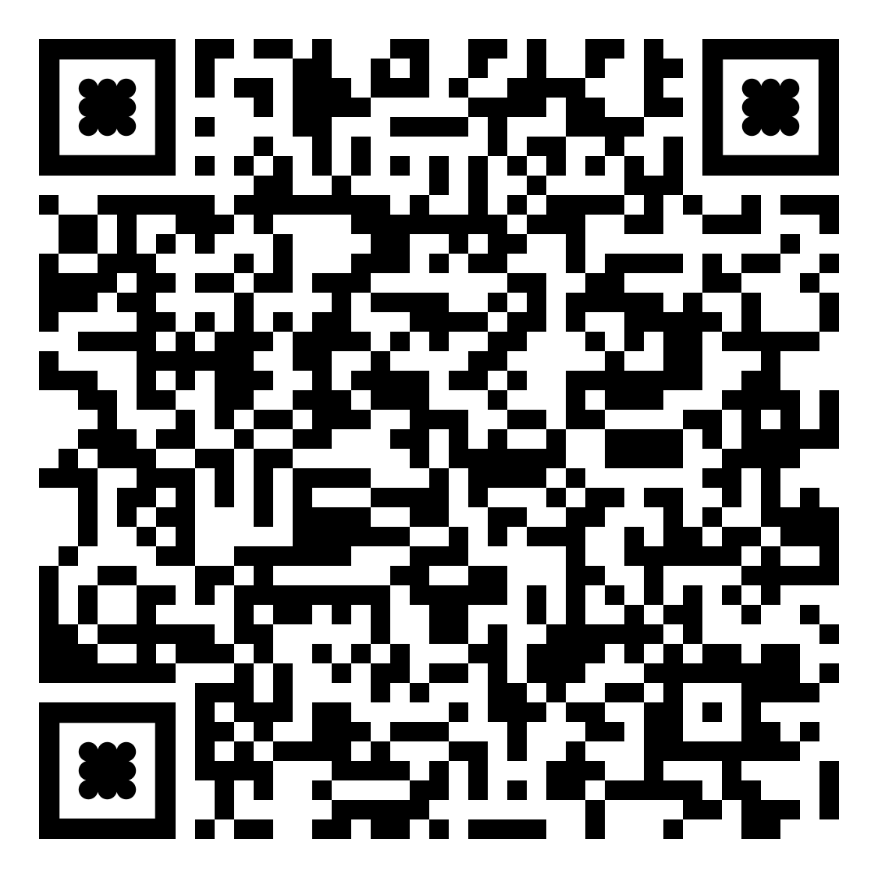
Sign up to participate!
Ambassador Sign-up
Tabling Sign-up

